Slide 1
Learning in AI, Learning Agent, Concepts of Supervised, Unsupervised, Semi -Supervised Learning, Reinforcement Learning, Ensemble Learning.

Slide 2
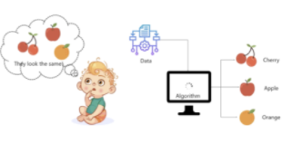
Learning
An agent is learning if it improves its performance on future tasks after making observations about the world. Learning can range from the trivial, as exhibited by jotting down a phone number, to the profound, as exhibited by Albert Einstein, who inferred a new theory of the universe.
Learning is a search through the space of possible hypotheses for one that will perform well, even on new examples beyond the training set. To measure the accuracy of a hypothesis we give it a test set of examples that are distinct from the training set.

Slide 3
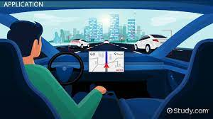
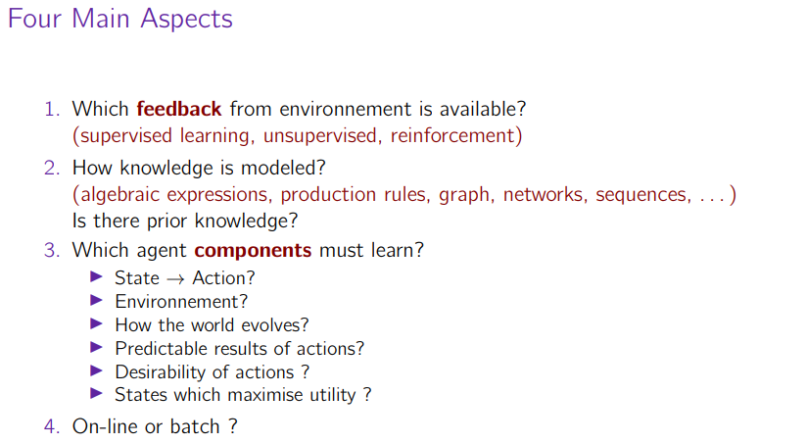
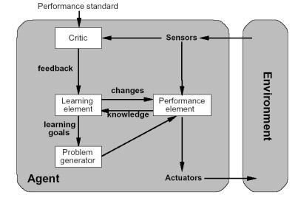
Pre-requisite:Learning agents

Slide 4
Why would we want an agent to learn?
If the design of the agent can be improved, why wouldn’t the designers just program in that improvement to begin with?
There are three main reasons.
First, the designers cannot anticipate all possible situations that the agent might find itself in. For example, a robot designed to navigate mazes must learn the layout of each new maze it encounters.
Second, the designers cannot anticipate all changes over time; a program designed to predict tomorrow’s stock market prices must learn to adapt when conditions change from boom to bust.
Third, sometimes human programmers have no idea how to program a solution themselves. For example, most people are good at recognizing the faces of family members, but even the best programmers are unable to program a computer to accomplish that task, except by using learning algorithms.

Slide 5
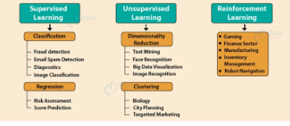
Types of Learning (Link)
Learning Problems
1. Supervised Learning(Ex. : Decision Trees, Neural Networks, SVMS)
2. Unsupervised Learning(Ex. : K-means, clustering, .)
3. Reinforcement Learning(App. : robots, autonomous vehicles, . . .)
Hybrid Learning Problems
4. Semi-Supervised Learning
5. Self-Supervised Learning
6. Multi-Instance Learning
Statistical Inference
7. Inductive Learning
8. Deductive Inference
9. Transductive Learning
Learning Techniques
10. Multi-Task Learning
11. Active Learning
12. Online Learning
13. Transfer Learning
14. Ensemble Learning

Slide 6
FORMS OF LEARNING
Any component of an agent can be improved by learning from data.
The improvements, and the techniques used to make them, depend on four major factors:
Which component is to be improved.
What prior knowledge the agent already has.
What representation is used for the data and the component.
What feedback is available to learn from. Next slide

Slide 7
Learning agent
The components of these agents include:
1. A direct mapping from conditions on the current state to actions.
2. A means to infer relevant properties of the world from the percept sequence.
3. Information about the way the world evolves and about the results of possible actions
the agent can take.
4. Utility information indicating the desirability of world states.
5. Action-value information indicating the desirability of actions.
6. Goals that describe classes of states whose achievement maximizes the agent’s utility.
Each of these components can be learned. Consider, for example, an agent training to become a taxi driver. Every time the instructor shouts “Brake!” the agent might learn a condition–action rule for when to brake (component 1); the agent also learns every time the instructor does not shout. By seeing many camera images that it is told contain buses, it can learn to recognize them (2). By trying actions and observing the results—for example, braking hard on a wet road—it can learn the effects of its actions (3). Then, when it receives no tip from passengers who have been thoroughly shaken up during the trip, it can learn a useful component of its overall utility function (4).

Slide 8
Representation and prior knowledge
We have seen several examples of representations for agent components: propositional and first-order logical sentences for the components in a logical agent; Bayesian networks for the inferential components of a decision-theoretic agent, and so on.
Effective learning algorithms have been devised for all of these representations. This includes a vector of attribute values—and outputs that can be either a continuous numerical value or a discrete Value.

Slide 9
Feedback to learn from
There are three types of feedback that determine the three main types of learning:
In unsupervised learning the agent learns patterns in the input even though no explicit feedback is supplied. For example, a taxi agent might gradually develop a concept of “good traffic days” and “bad traffic days” without ever being given labeled examples of each by a teacher.
In reinforcement learning the agent learns from a series of reinforcements—rewards.or punishments. For example, the lack of a tip at the end of the journey gives the taxi agent an indication that it did something wrong. The two points for a win at the end of a chess game tells the agent it did something right. It is up to the agent to decide which of the actions prior to the reinforcement were most responsible for it.
In supervised learning the agent observes some example input–output pairs and learns a function that maps from input to output. In component 1 above, the inputs are percepts and the output are provided by a teacher who says “Brake!” or “Turn left.” In component 2, the inputs are camera images and the outputs again come from a teacher who says “that’s a bus.”In 3, the theory of braking is a function from states and braking actions to stopping distance in feet. In this case the output value is available directly from the agent’s percepts (after the fact); the environment is the teacher.

Slide 10
CONTD…
In practice, these distinction are not always so crisp.
In semi-supervised learning we are given a few labeled examples and must make what we can of a large collection of unlabeled examples. Even the labels themselves may not be the oracular truths that we hope for. Imagine that you are trying to build a system to guess a person’s age from a photo.
You gather some labeled examples by snapping pictures of people and asking their age. That’s supervised learning. But in reality some of the people lied about their age. It’s not just that there is random noise in the data; rather the inaccuracies are systematic, and to uncover them is an unsupervised learning problem involving images, self-reported ages, and true (unknown) ages. Thus, both noise and lack of labels create a continuum between supervised and unsupervised learning.

Slide 11
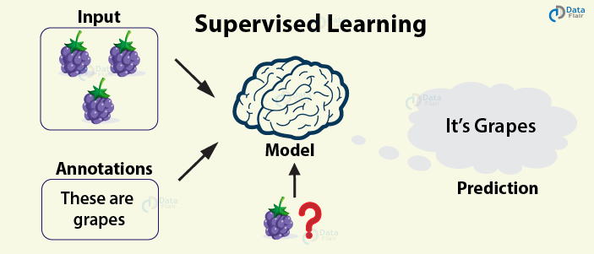
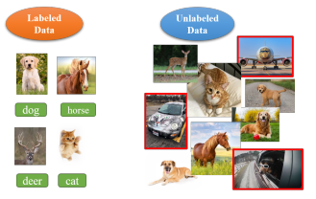
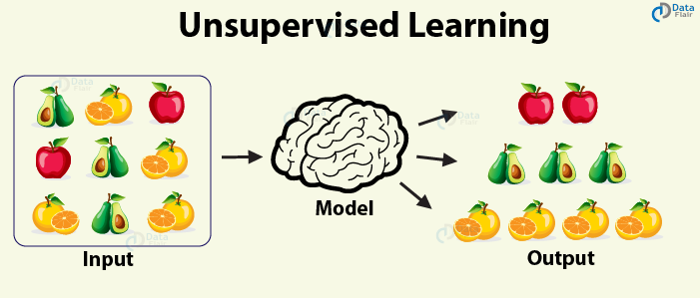

Slide 12
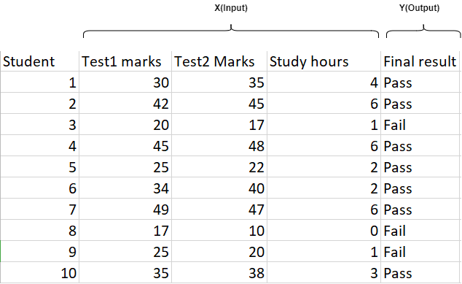
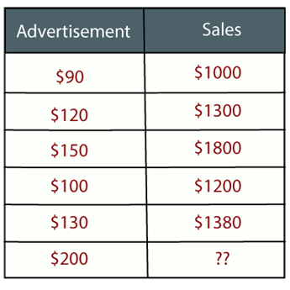
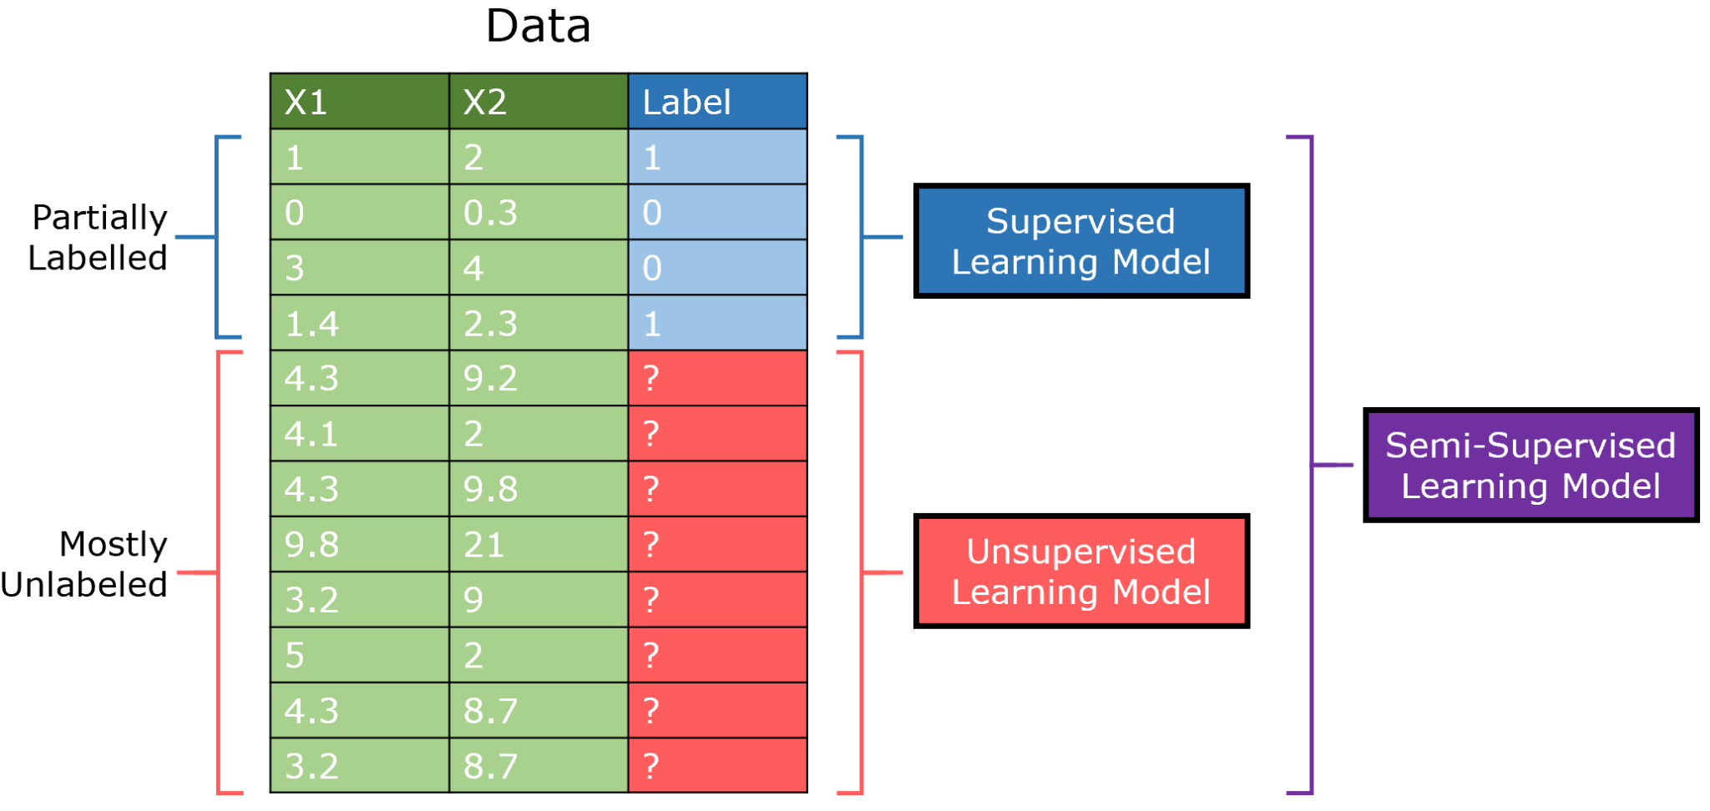


Slide 13
Supervised learning
The task of supervised learning is this:
TRAINING SET Given a training set of N example input–output pairs (x1, y1),(x2, y2),...(xN , yN ) , where each yj was generated by an unknown function y = f(x), discover a function h that approximates the true function f.
Here x and y can be any value; they need not be numbers. The function h is a hypothesis.
Learning is a search through the space of possible hypotheses for one that will perform well, even on new examples beyond the training set. To measure the accuracy of a hypothesis we TEST SET give it a test set of examples that are distinct from the training set.
When the output y is one of a finite set of values (such as sunny, cloudy or rainy), the learning problem is called classification, and is called Boolean or binary classification if there are only two values. When y is a number (such as tomorrow’s temperature), the learning problem is called regression.

Slide 14
There are two main types of supervised learning problems: they are classification that involves predicting a class label and regression that involves predicting a numerical value.
Classification: Supervised learning problem that involves predicting a class label.
Regression: Supervised learning problem that involves predicting a numerical label.
Both classification and regression problems may have one or more input variables and input variables may be any data type, such as numerical or categorical.
An example of a classification problem would be the MNIST handwritten digits dataset where the inputs are images of handwritten digits (pixel data) and the output is a class label for what digit the image represents (numbers 0 to 9).
An example of a regression problem would be the Boston house prices dataset where the inputs are variables that describe a neighborhood and the output is a house price in dollars.

Slide 15
Unsupervised learning
It describes a class of problems that involves using a model to describe or extract relationships in data
There are many types of unsupervised learning, although there are two main problems that are often encountered by a practitioner: they are clustering that involves finding groups in the data and density estimation that involves summarizing the distribution of data.
Clustering: Unsupervised learning problem that involves finding groups in data.
Density Estimation: Unsupervised learning problem that involves summarizing the distribution of data.

Slide 16
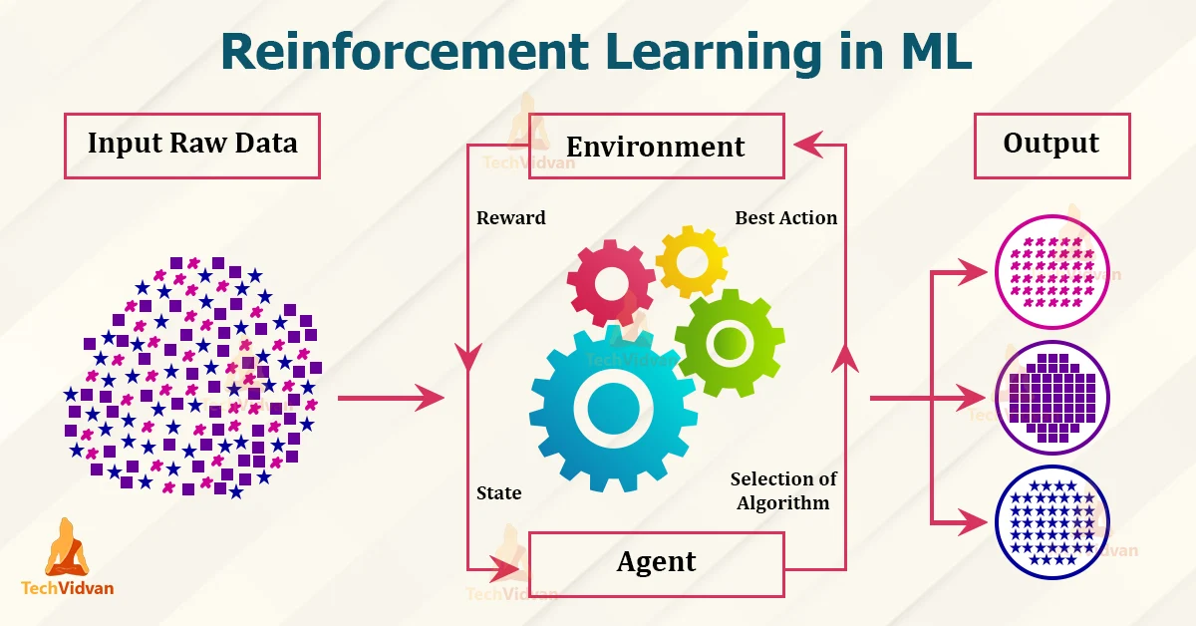
Reinforcement learning
It describes a class of problems where an agent operates in an environment and must learn to operate using feedback.
Reinforcement learning is learning what to do — how to map situations to actions—so as to maximize a numerical reward signal. The learner is not told which actions to take, but instead must discover which actions yield the most reward by trying them.
The use of an environment means that there is no fixed training dataset, rather a goal or set of goals that an agent is required to achieve, actions they may perform, and feedback about performance toward the goal.

Slide 17
contd…
It is similar to supervised learning in that the model has some response from which to learn, although the feedback may be delayed and statistically noisy, making it challenging for the agent or model to connect cause and effect.
An example of a reinforcement problem is playing a game where the agent has the goal of getting a high score and can make moves in the game and received feedback in terms of punishments or rewards.
In many complex domains, reinforcement learning is the only feasible way to train a program to perform at high levels. For example, in game playing, it is very hard for a human to provide accurate and consistent evaluations of large numbers of positions, which would be needed to train an evaluation function directly from examples. Instead, the program can be told when it has won or lost, and it can use this information to learn an evaluation function that gives reasonably accurate estimates of the probability of winning from any given position.

Slide 18
Reinforcement learning
Q learning
State–action–reward–state–action (SARSA)
Deep Q Learning
deep deterministic policy gradient (DDPG)

Slide 19
Statistical Learning
It is a set of tools for understanding data. These tools broadly come under two classes: supervised learning & unsupervised learning.
Let, suppose that we observe a response Y and p different predictors X = (X₁, X₂,…., Xp). In general, we can say:
Y =f(X) + ε
Here f is an unknown function, and ε is the random error term.
In essence, statistical learning refers to a set of approaches for estimating f.
In cases where we have set of X readily available, but the output Y, not so much, the error averages to zero, and we can say:
¥ = ƒ(X)
where ƒ represents our estimate of f and ¥ represents the resulting prediction.

Slide 20
contd…
Hence for a set of predictors X, we can say:
E(Y — ¥)² = E[f(X) + ε — ƒ(X)]²
=> E(Y — ¥)² = [f(X) - ƒ(X)]² + Var(ε)
where,
E(Y—¥)² represents the expected value of the squared difference between actual and expected result.
[f(X)—ƒ(X)]² represents the reducible error. It is reducible because we can potentially improve the accuracy of ƒ by better modeling.
Var(ε) represents the irreducible error. It is irreducible because no matter how well we estimate ƒ, we cannot reduce the error introduced by variance in ε.
Regression Vs Classification Problem
Variables, Y, can be broadly be characterised as quantitative or qualitative( also known as categorical). Quantitative variables take on numerical values, e.g., age, height, income, price, and much more. Estimating qualitative responses is often termed as a regression problem. Qualitative variables take on categorical values, e.g., gender, brand, parts of speech, and much more. Estimating qualitative responses is often termed as a classification problem.

Slide 21
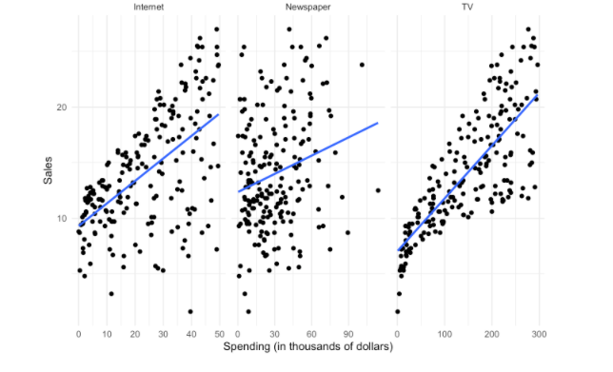
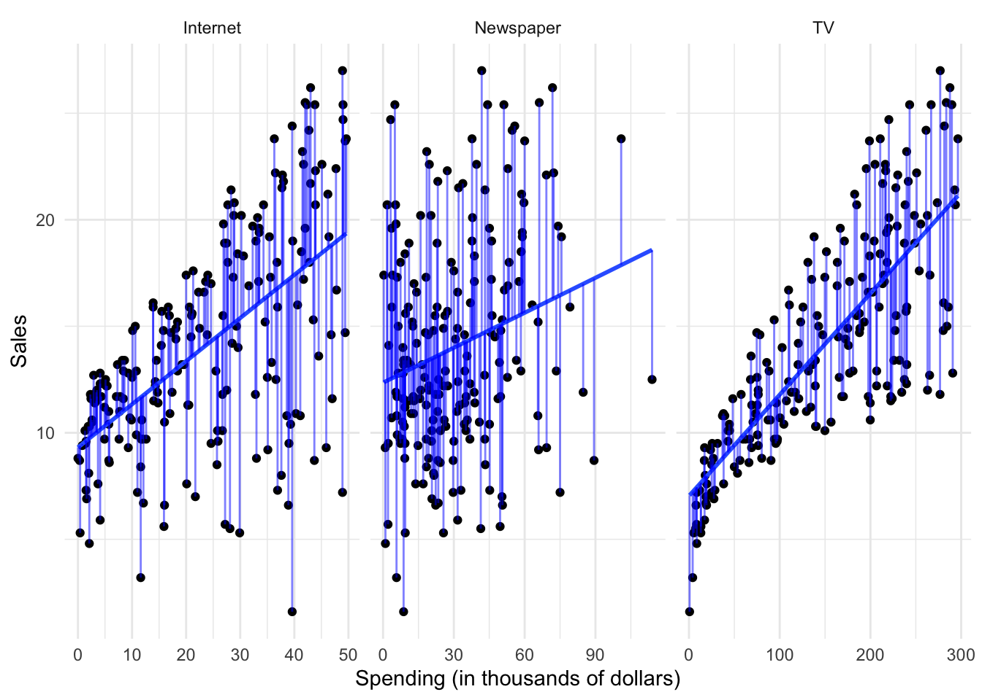
In this example, the advertising budgets are our input variables, also called independent variables, features, or predictors. The sales of the product is the output, also called the dependent variable or response.
By plotting the variables against one another using a scatterplot, we can see there is some sort of relationship between each medium’s advertising spending and product sales:

Slide 22
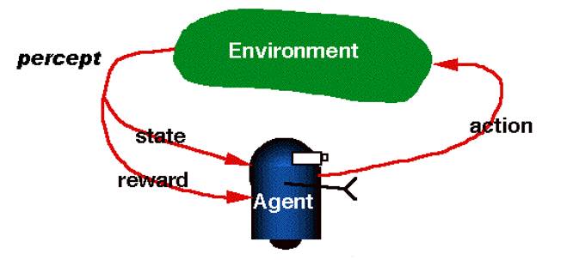
Reinforcement learning
Reinforcement Learning(RL) is a type of machine learning technique that enables an agent to learn in an interactive environment by trial and error using feedback from its own actions and experiences. Though both supervised and reinforcement learning use mapping between input and output, unlike supervised learning where the feedback provided to the agent is correct set of actions for performing a task, reinforcement learning uses rewards and punishments as signals for positive and negative behavior. As compared to unsupervised learning, reinforcement learning is different in terms of goals. While the goal in unsupervised learning is to find similarities and differences between data points, in the case of reinforcement learning the goal is to find a suitable action model that would maximize the total cumulative reward of the agent. The figure below illustrates the action-reward feedback loop of a generic RL model.

Slide 23
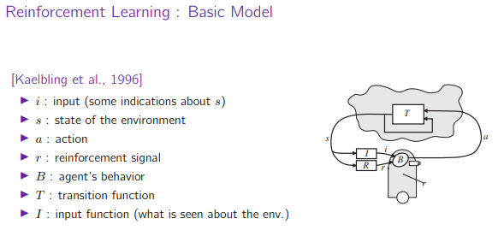

Slide 24
Agent: It is an assumed entity which performs actions in an environment to gain some reward.
Environment (e): A scenario that an agent has to face.
Reward (R): An immediate return given to an agent when he or she performs specific action or task.
State (s): State refers to the current situation returned by the environment.
Policy (π): It is a strategy which applies by the agent to decide the next action based on the current state.
Value (V): It is expected long-term return with discount, as compared to the short-term reward.
Value Function: It specifies the value of a state that is the total amount of reward. It is an agent which should be expected beginning from that state.
Model of the environment: This mimics the behavior of the environment. It helps you to make inferences to be made and also determine how the environment will behave.
Model based methods: It is a method for solving reinforcement learning problems which use model-based methods.
Q value or action value (Q): Q value is quite similar to value. The only difference between the two is that it takes an additional parameter as a current acti

Slide 25
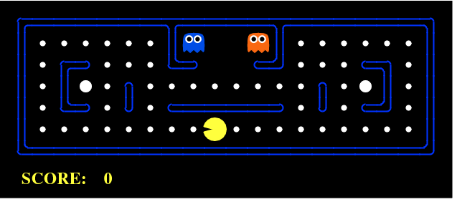
PACMAN
An RL problem can be best explained through games. Here the goal of the agent(PacMan) is to eat the food in the grid while avoiding the ghosts on its way. In this case, the grid world is the interactive environment for the agent where it acts. Agent receives a reward for eating food and punishment if it gets killed by the ghost (loses the game). The states are the location of the agent in the grid world and the total cumulative reward is the agent winning the game.In order to build an optimal policy, the agent faces the dilemma of exploring new states while maximizing its overall reward at the same time. This is called Exploration vs Exploitation trade-off. To balance both, the best overall strategy may involve short term sacrifices. Therefore, the agent should collect enough information to make the best overall decision in the future.

Slide 26
There are mainly three ways to implement reinforcement-learning in ML, which are:
Value-based: The value-based approach is about to find the optimal value function, which is the maximum value at a state under any policy. Therefore, the agent expects the long-term return at any state(s) under policy π.
Policy-based: Policy-based approach is to find the optimal policy for the maximum future rewards without using the value function. In this approach, the agent tries to apply such a policy that the action performed in each step helps to maximize the future reward. The policy-based approach has mainly two types of policy:
Deterministic: The same action is produced by the policy (π) at any state.
Stochastic: In this policy, probability determines the produced action.
Model-based:
In the model-based approach, a virtual model is created for the environment, and the agent explores that environment to learn it. There is no particular solution or algorithm for this approach because the model representation is different for each environment.

Slide 27
Practical applications of Reinforcement Learning
Since, RL requires a lot of data, therefore it is most applicable in domains where simulated data is readily available like gameplay, robotics.
RL is quite widely used in building AI for playing computer games. AlphaGo Zero is the first computer program to defeat a world champion in the ancient Chinese game of Go. In robotics and industrial automation, RL is used to enable the robot to create an efficient adaptive control system for itself which learns from its own experience and behavior. DeepMind’s work on Deep Reinforcement Learning for Robotic Manipulation with Asynchronous Policy updates is a good example of the same(LINK)
Other applications of RL include abstractive text summarization engines, dialog agents(text, speech) which can learn from user interactions and improve with time, learning optimal treatment policies in healthcare and RL based agents for online stock trading.

Slide 28
Robotics:
RL is used in Robot navigation, Robo-soccer, walking, juggling, etc.
Control:
RL can be used for adaptive control such as Factory processes, admission control in telecommunication, and Helicopter pilot is an example of reinforcement learning.
Game Playing:
RL can be used in Game playing such as tic-tac-toe, chess, etc.
Chemistry:
RL can be used for optimizing the chemical reactions.
Business:
RL is now used for business strategy planning.
Manufacturing:
In various automobile manufacturing companies, the robots use deep reinforcement learning to pick goods and put them in some containers.
Finance Sector:
The RL is currently used in the finance sector for evaluating trading strategies.

Slide 29
Reinforcement learning is all about making decisions sequentially. In simple words, we can say that the output depends on the state of the current input and the next input depends on the output of the previous input | In Supervised learning, the decision is made on the initial input or the input given at the start
In Reinforcement learning decision is dependent, So we give labels to sequences of dependent decisions | In supervised learning the decisions are independent of each other so labels are given to each decision.
Example: Chess game | Example: Object recognition

Slide 30
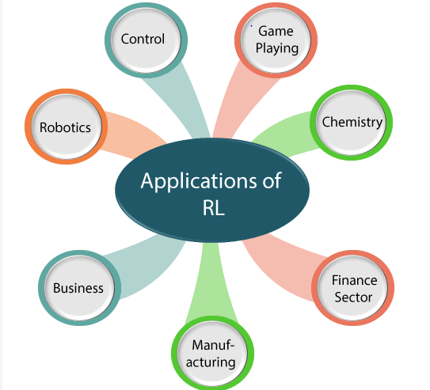
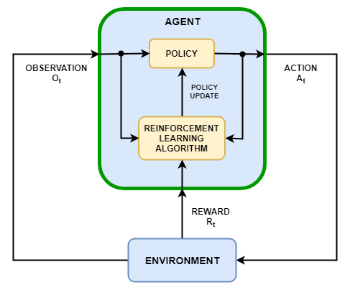
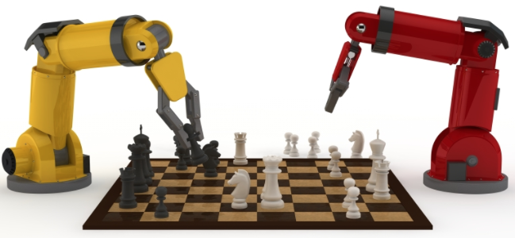

Slide 31
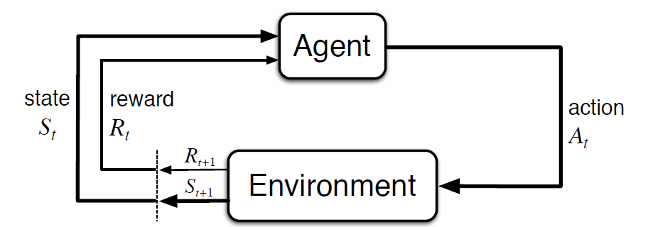
Markov Decision Process (MDP) is a mathematical framework to describe an environment in reinforcement learning.
The agent and the environment interact at each discrete time step, t = 0, 1, 2, 3…At each time step, the agent gets information about the environment state St. Based on the environment state at instant t, the agent chooses an action At. In the following instant, the agent also receives a numerical reward signal Rt+1. This thus gives rise to a sequence like S0, A0, R1, S1, A1, R2…
The random variables Rt and St have well defined discrete probability distributions. These probability distributions are dependent only on the preceding state and action by virtue of Markov Property. Let S, A, and R be the sets of states, actions, and rewards. Then the probability that the values of St, Rt and At taking values s’, r and a with previous state s is given by,

Slide 32
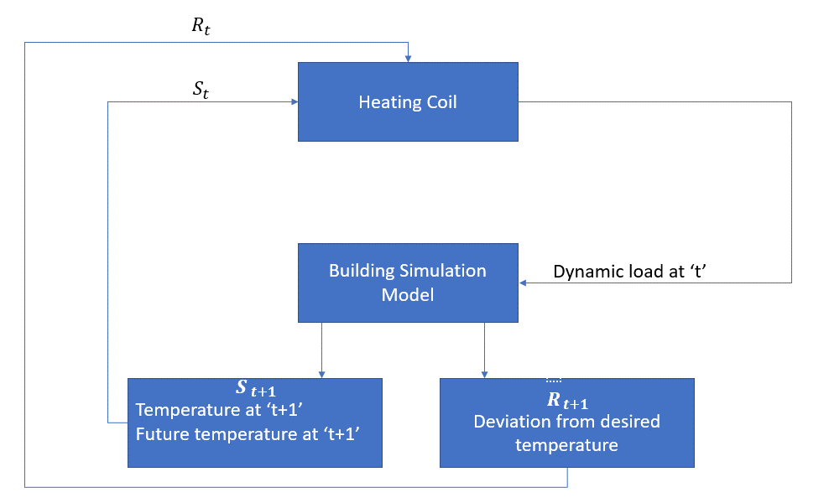

Slide 33
RL can be used to implement a control strategy for a heating process.
The idea is to control the temperature of a room within the specified temperature limits. The temperature inside the room is influenced by external factors such as outside temperature, the internal heat generated, etc.
The agent, in this case, is the heating coil which has to decide the amount of heat required to control the temperature inside the room by interacting with the environment and ensure that the temperature inside the room is within the specified range. The reward, in this case, is basically the cost paid for deviating from the optimal temperature limits.
The action for the agent is the dynamic load. This dynamic load is then fed to the room simulator which is basically a heat transfer model that calculates the temperature based on the dynamic load. So, in this case, the environment is the simulation model. The state variable St contains the present as well as future rewards.
The following block diagram explains how MDP can be used for controlling the temperature inside a room:
Limitations of this Method
Reinforcement learning learns from the state. The state is the input for policymaking. Hence, the state inputs should be correctly given. Also as we have seen, there are multiple variables and the dimensionality is huge. So using it for real physical systems would be difficult!

Slide 34
Reinforcement learning
Q learning
State–action–reward–state–action (SARSA)
Deep Q Learning
deep deterministic policy gradient (DDPG)

Slide 35
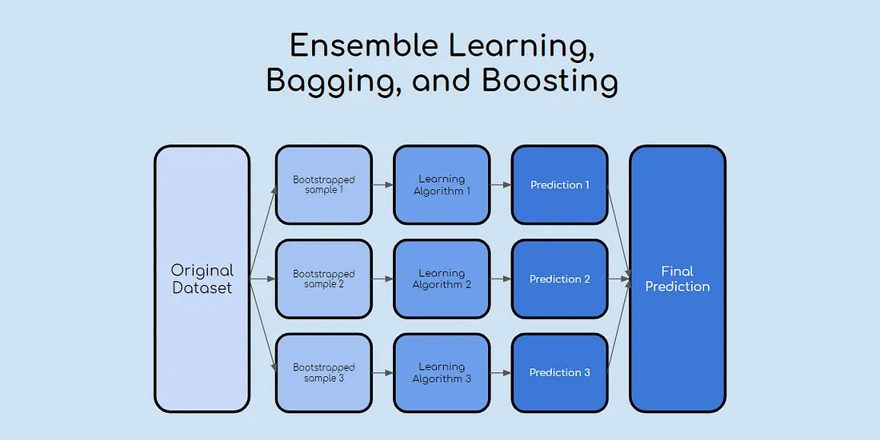
Ensemble Learning
Bagging involves fitting many decision trees on different samples of the same dataset and averaging the predictions.
Stacking involves fitting many different models types on the same data and using another model to learn how to best combine the predictions.
Boosting involves adding ensemble members sequentially that correct the predictions made by prior models and outputs a weighted average of the predictions.
Random forest algorithm is an ensemble learning technique combining numerous classifiers to enhance a model's performance. Random Forest is a supervised machine-learning algorithm made up of decision trees

Slide 36
references
MDP
ACTIVE PASSIVE
UC berkekely
PAC
Active Vs Passive Learning
Prof. David
Reinforcement Learning

